Slide 1
Approximate Circuits in Low-Power Image and Video Processing: The Approximate Median Filter
Lukas Sekanina, Zdenek Vasicek, Vojtech Mrazek
Faculty of Information Technology, IT4Innovations Centre of Excellence, Brno University of Technology, Czech Republic

Slide 2
Approximate Computing
Quick Overview
Approximate computing relaxes precise requirements
Improves performance and lowers power consumption
Enforced through software/hardware
“Dark Silicon”-Not all transistors can be used at the same time
High operating frequency has thermal issues
Solution is having less requirements on precise computing
Different errors are measured in Approximate Computing
Average error
Error probability
Worst case error
Notes:
precision scaling, loop perforation, load value approximation, memorization, task dropping/skipping, memory access skip- ping, using different SW/HW versions, refresh rate reducing in memory, inexact read/write and relaxed synchronization.
The errors induced by approximation are measured using various error metrics such as the average error, error probability, and worst case error.

Slide 3
Background
Image and video processing is highly resilient when it comes to errors
Generally real time constraints are met with specialized hardware
Field Programmable Gate Arrays - (FPGAs)
Application-Specific Integrated Circuits - (ASIC)
Push for lower power consumption using circuit approximation methods for image and video processing
Circuit Approximations is next best thing!

Slide 4
Goal for Approximate Circuits
Create approximate circuit with best trade-off between error, performance, and power consumption
Looked at components most commonly approximated and methods used for approximation
Median-outputting circuit (or median filter for short) is one of these components
Notes:
Multi-Objective Optimization problem

Slide 5
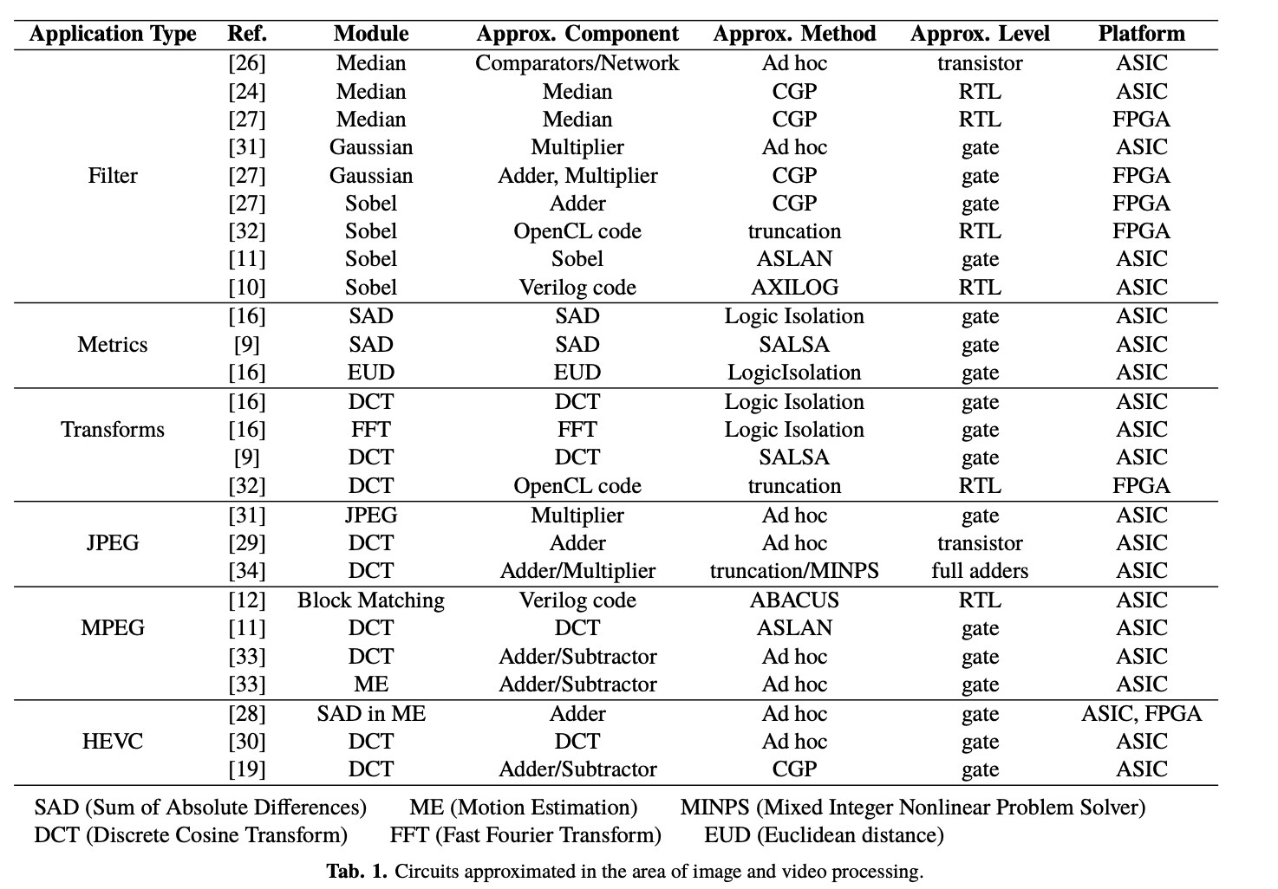
Approximate Circuits for Image and Video Processing

Slide 6
Case Study - Action and Issues
Chose to approximate the circuits implementing the shot noise image filter
Chose CGP because highly competitive compared to other types of circuit approximations
Compare two different approximation strategies based on Cartesian genetic programming (CGP)
Start with median filter and remove circuit components
Uses CGP to evolve the image filter from scratch based on the training data supplied during the evolution
Notes:
These Cartesian Genetic programming approximation are applied to approximate common implementations of the median filter
The first strategy starts with an exact median filter implementation and tries to remove some circuit components (comparators) and reconnect the remaining ones in such a way that the error of filtering is minimized
The second strategy employs CGP to evolve the image filter from scratch; only on the basis of the training data supplied during the evolution

Slide 7
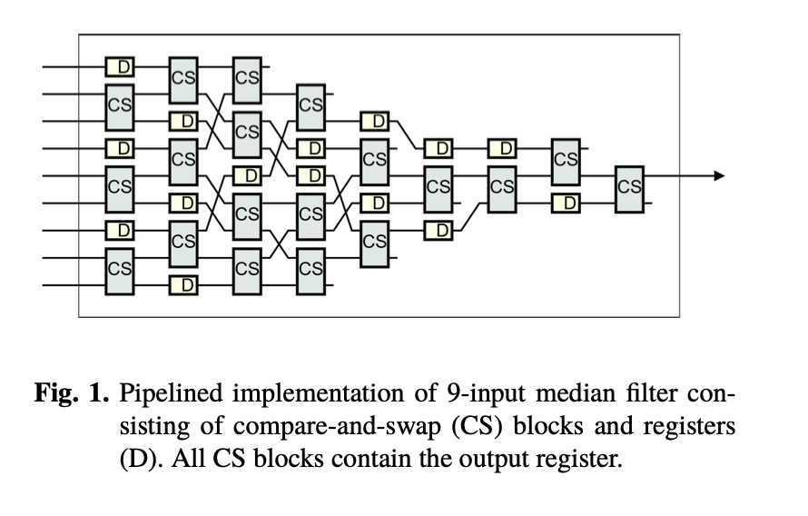
Median Filters (MF)
Shot noise elimination filters
Generally calculates median over the pixels belonging to the filtering window
Median Filters are special case of order statistic filters
Replaces value of every pixel of the filtered image by the median of its neighbors
Pipelined implementation based on a median network
Center Weighted Median Filter
Only the central value of the window is counted with additional weight
Notes:
Pipelined implementation is good for high performance applications
median network consists of a sequence of compare-and-swap operations
Each compare-and-swap (CS) operation acts as a small 2- input sorting network
produces a sorted sequence by outputting the minimum and maximum of the input values.

Slide 8
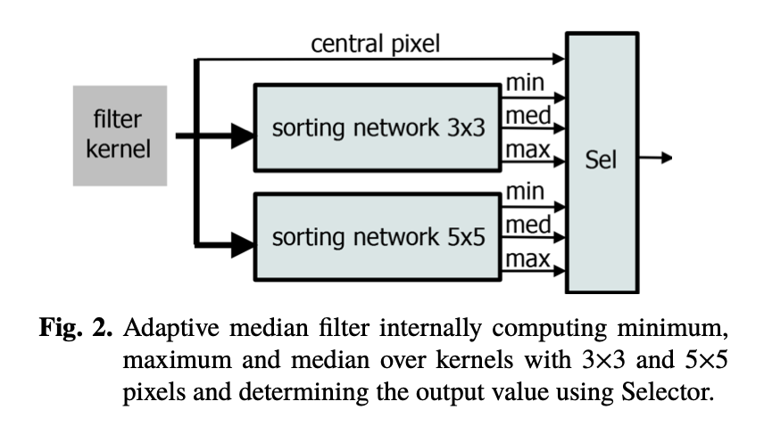
Median Filter
Remove noisy pixels but also remove desirable details
Adaptive Median Filter (AMF) - Represents multi-level approach to try detecting and replacing corrupted pixels only

Slide 9
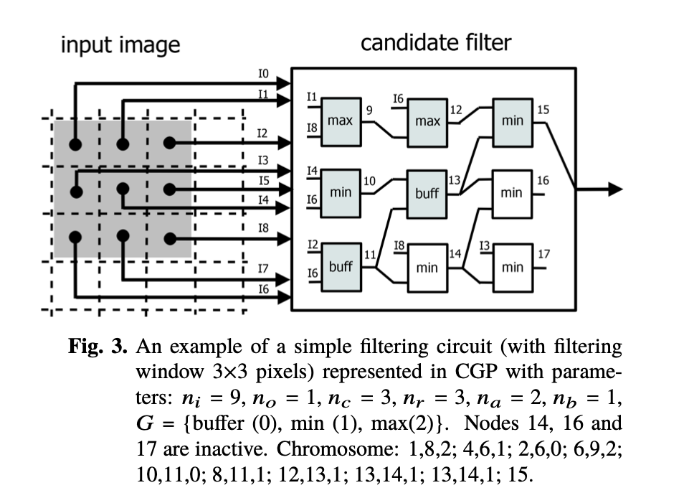
Evolutionary Approximation - CGP
Ni - Primary Inputs
No - Primary Outputs
Nc - Columns
Nr - Rows
Na - Destination Address
Nb - Function Codes from G
G is the set of possible Functions
Candidate circuit is represented by Nc*Nr*(Na+Nb)+No to signify number of integers in circuit

Slide 10
Evolutionary Approximation - CGP
Search is usually done with (1+ƛ) evolutionary algorithm
Every new population will consist of best individual from previous population and several of its offsprings created by a mutation operator
Runs for several populations
Fitness function is then used to choose “best” individual
Any multi-objective optimization algorithm can be taken
Notes:
ƛ is offsprings
1 is best individual

Slide 11
Approximation Strategies Using CGP
Start with median filter and remove circuit components (AS1)
Seed CGP with best known implementation of median filters
Evolve Approximate median filters by removing components
Entire image filtering function is evolved with CGP from scratch (AS2)
Uses function set G (All possible components)
Holistically creates new filter with lowest possible error
Error is calculated using the mean absolute error (MAE)

Slide 12
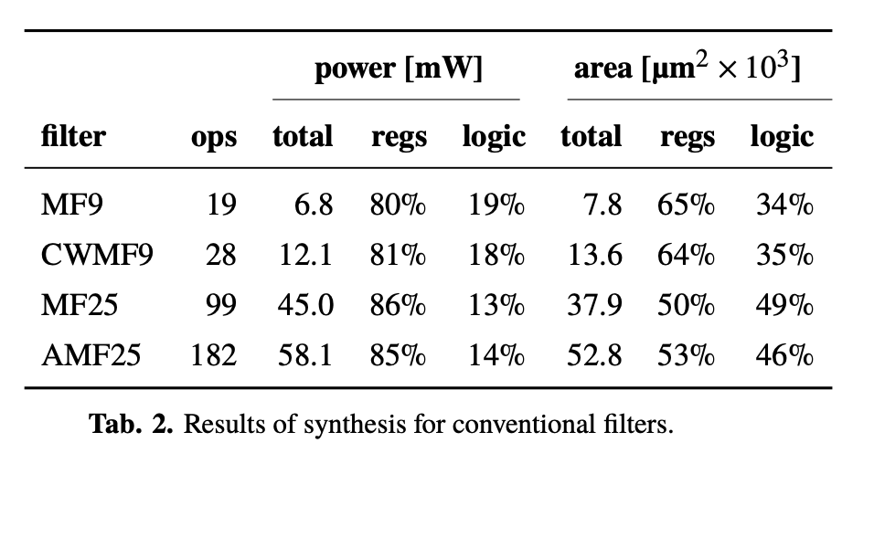
Results - Conventional Filters
Notes:
Display different conventional filters
Important things to know about this slide eis that Ops signifies number of Compare-and-swap operations
Each compare-and-swap operation is implemented using an 8-bit magnitude compara- tor and two 8-bit multiplexers.
Delay is insignificant because the timing constraints created by them were all met
the common median filter operating with 3 × 3 pixels is the cheapest solution. If we extend the filter window to 5 × 5, the power consumption increases more than 6 times and the area on a chip increases nearly 5 times. The adaptive median filter represents the most complex and power-demanding filter in our study. Its power consumption is more than 8 times higher compared to MF9. The implementation costs of CWMF is between MF9 and MF25 since CWMF9 is, in fact, a median network with 11 inputs whose three inputs are connected to the central pixel of the filter window. The power as well as the area on a chip are doubled compared to MF9.

Slide 13
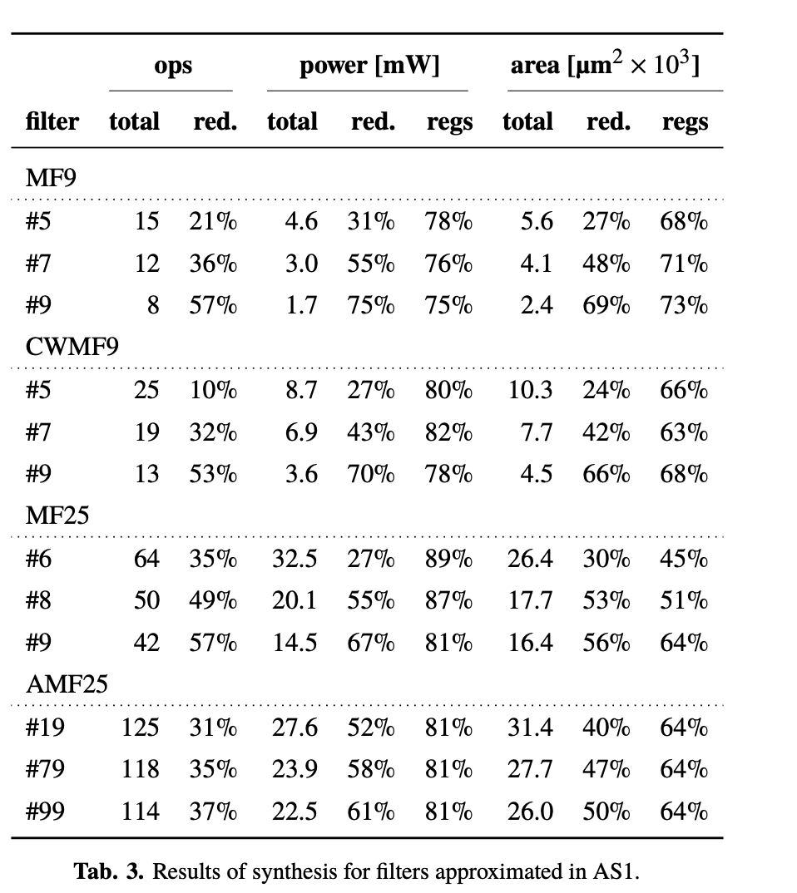
Results- Removing Hardware
Lowering number of compare/swap operations reduces power consumption and area
CGP operated with na = nb = 2, λ = 20, h = 5, and 10⁷ generations were produced
Notes:
pruning of the number of compare- and-swap operations and their rearranging enables to sig- nificantly reduce not only the area on a chip but also the power consumption.

Slide 14
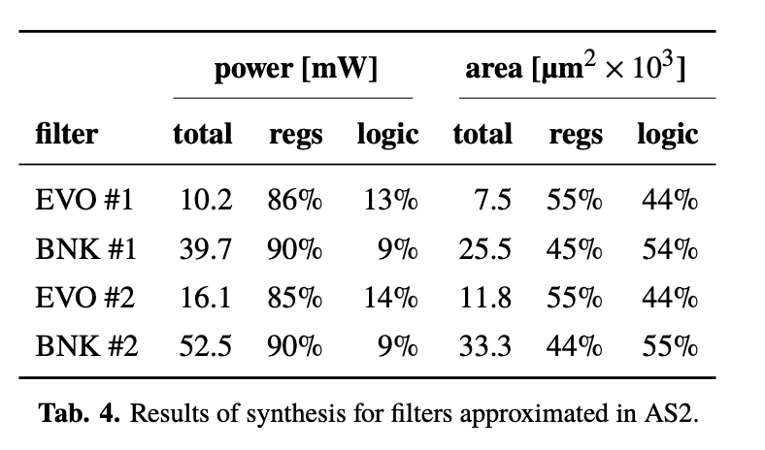
Results-Creating Filters
Start off with randomly generated population
Has 8-bit functions to use (minimum, maximum, addition, absolute difference, conditional assignment)
nc =7,nr =9,na =2,nb =1,λ=7,h=15

Slide 15
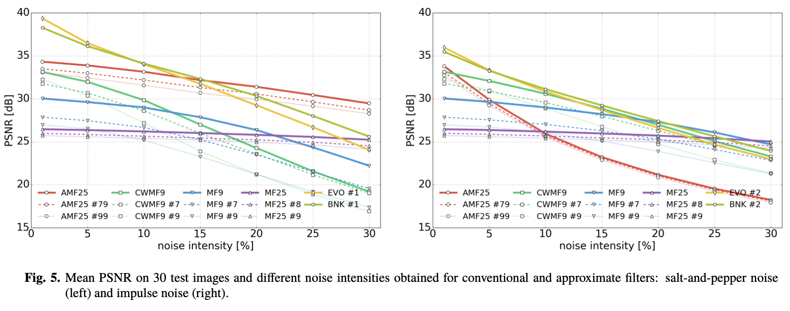
Results-Filtering Quality

Slide 16
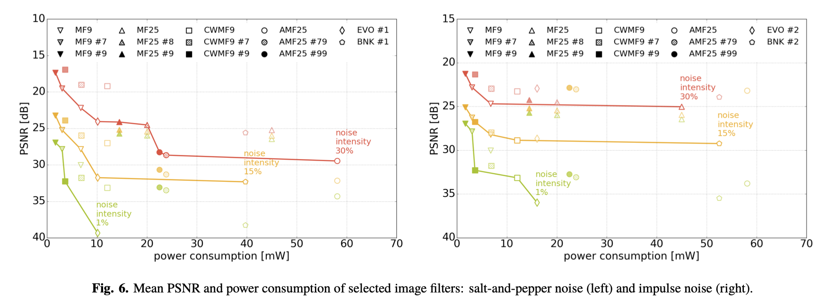
Results-Filtering Quality
Notes:
mean PSNR indicates that filters evolved in AS2 significantly outperform other filters especially if the noise intensity is lower

Slide 17
Conclusion
AS1 Approximate circuits
Advantages: Significantly reduced power consumption and area
Disadvantage: Slightly worse filtering quality
AS2 Approximate circuit
CGP was not biased to be a conventional design
Delivered a new well-optimized filtering structures
Complete resynthesizing of the circuit rather than approximating conventional solution has better trade-offs
Filtering quality is important

Slide 18
Sample Questions
When it comes to creating approximated circuits for image and video processing using CGP
It is necessary to have an established circuit to seed the CGP
One of the three criteria (error, performance, and power consumption) has to be prioritized
Creating an approximate circuit from scratch will create the solution with best results in a low-noise environment
Specialized hardware is necessary for this step
A simple Median Filter that has a pipelined implementation is composed of
Compare and Swap
Registers
Chip Selects
A and B
The reason why Salt and Pepper noise is easier to filter over impulse noise is because
Filters are trained on finding salt and pepper noise
Impulse noise can have subtle changes while salt and pepper must be big changes
Salt and pepper has a pattern that is easy to find
Impulse noise is very sporadic

